Slide 1


Exposure CS 2021
for CS1
Chapter 6 Section 1-3 Slides
More Python Libraries:
math Library Functions
PowerPoint Presentation
created by:
Mr. John L. M. Schram
and Mr. Leon Schram
Authors of Exposure
Computer Science

Slide 2
Section 6.2
Library
Components

Slide 3

The Toolbox Analogy
A library is like a toolbox.
A library can have several subroutines
just like a toolbox can have several
tools.
Before any of these tools can be used, you
must first find (import) their specific toolbox.

Slide 4
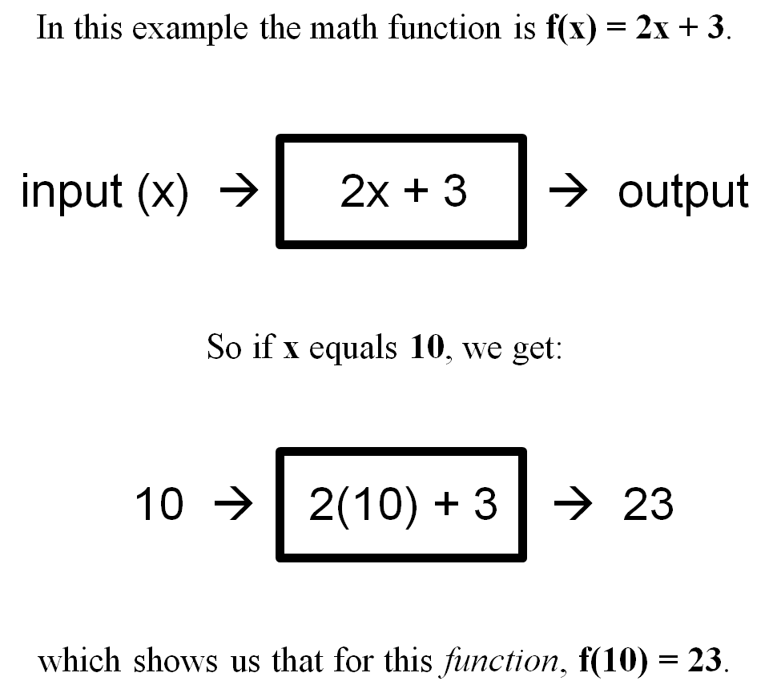
Review of a Mathematical Function

Slide 5
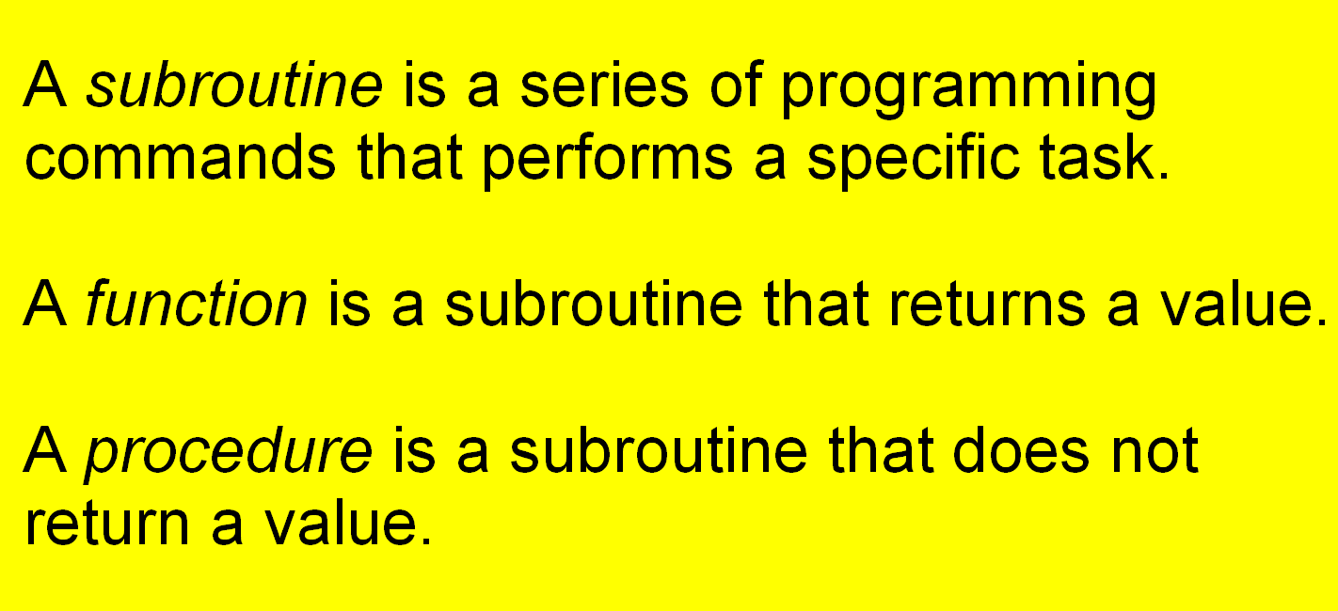
Subroutines, Functions and Procedures

Slide 6
Section 6.3
math Library
Functions

Slide 7
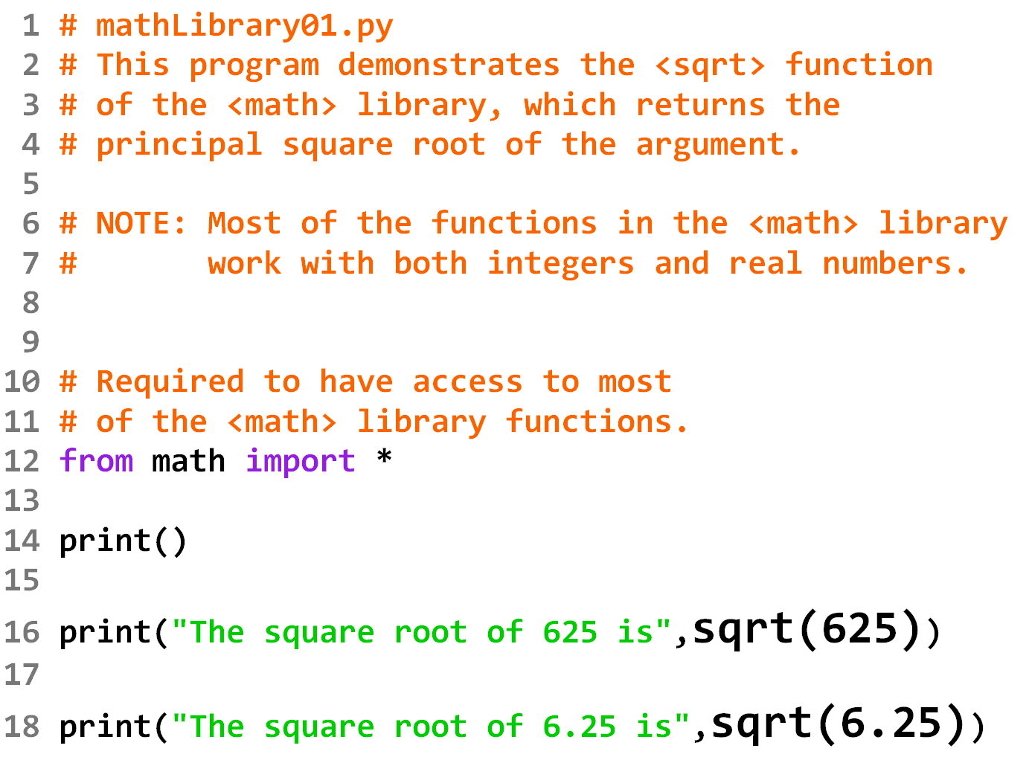

Slide 8
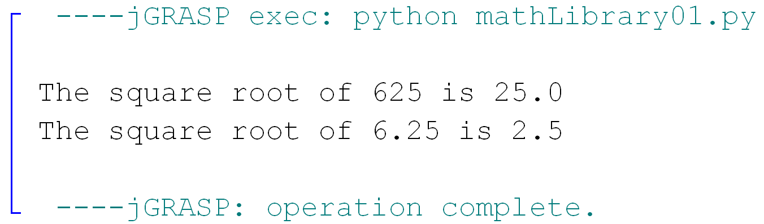

Slide 9
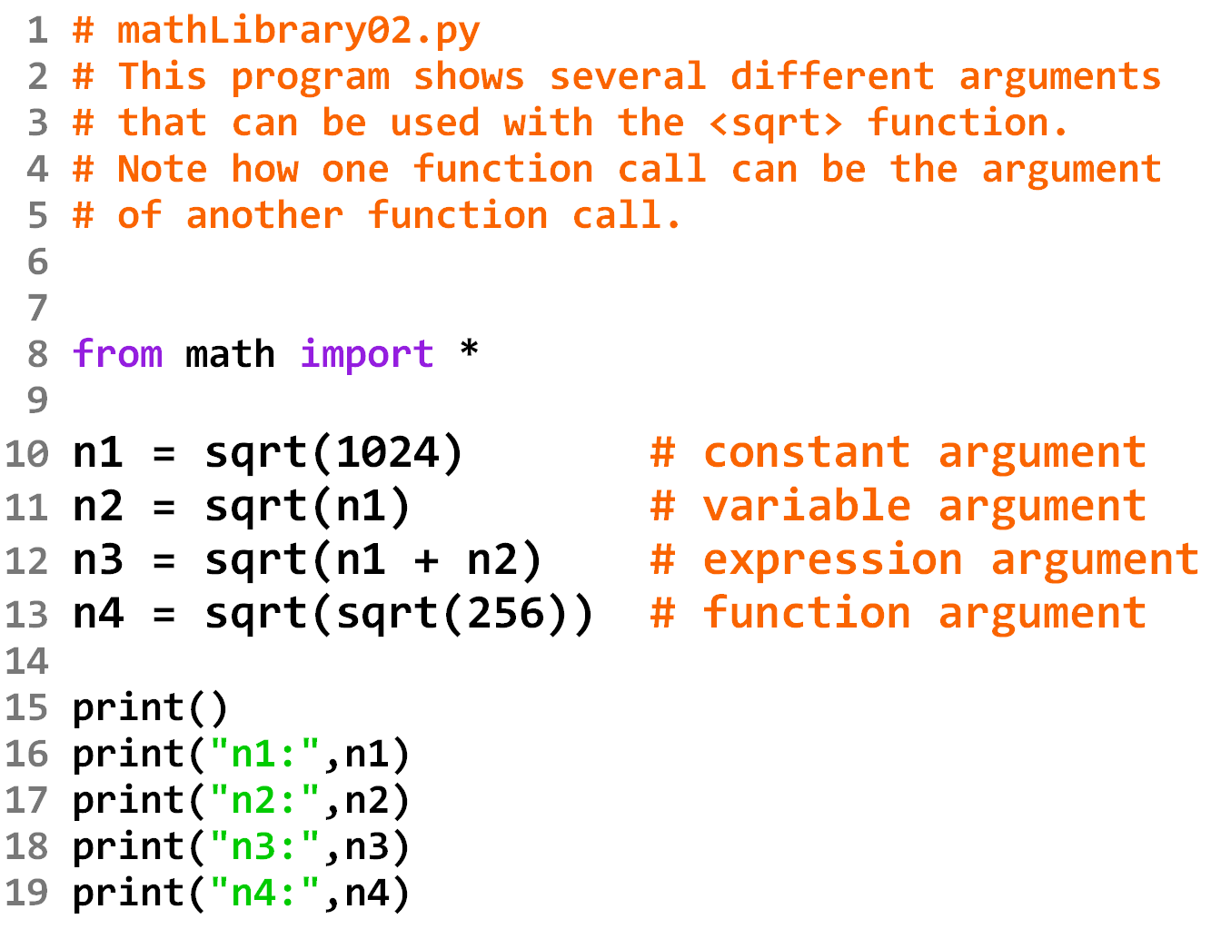

Slide 10
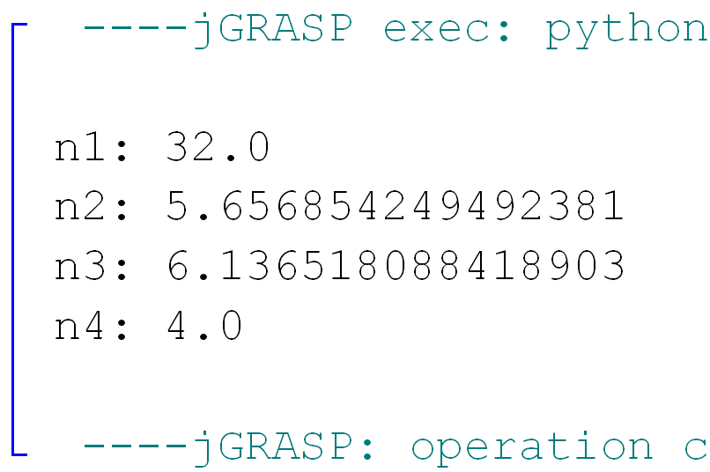

Slide 11
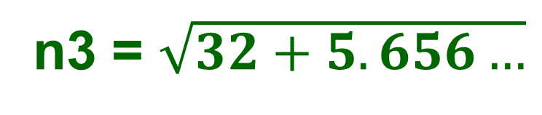
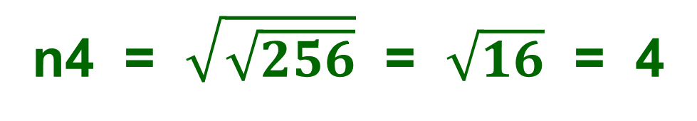
n3 = $\sqrt{32+5.656…}$
n4 = $\sqrt{\sqrt{256}}$ = $\sqrt{16}$ = 4

Slide 12
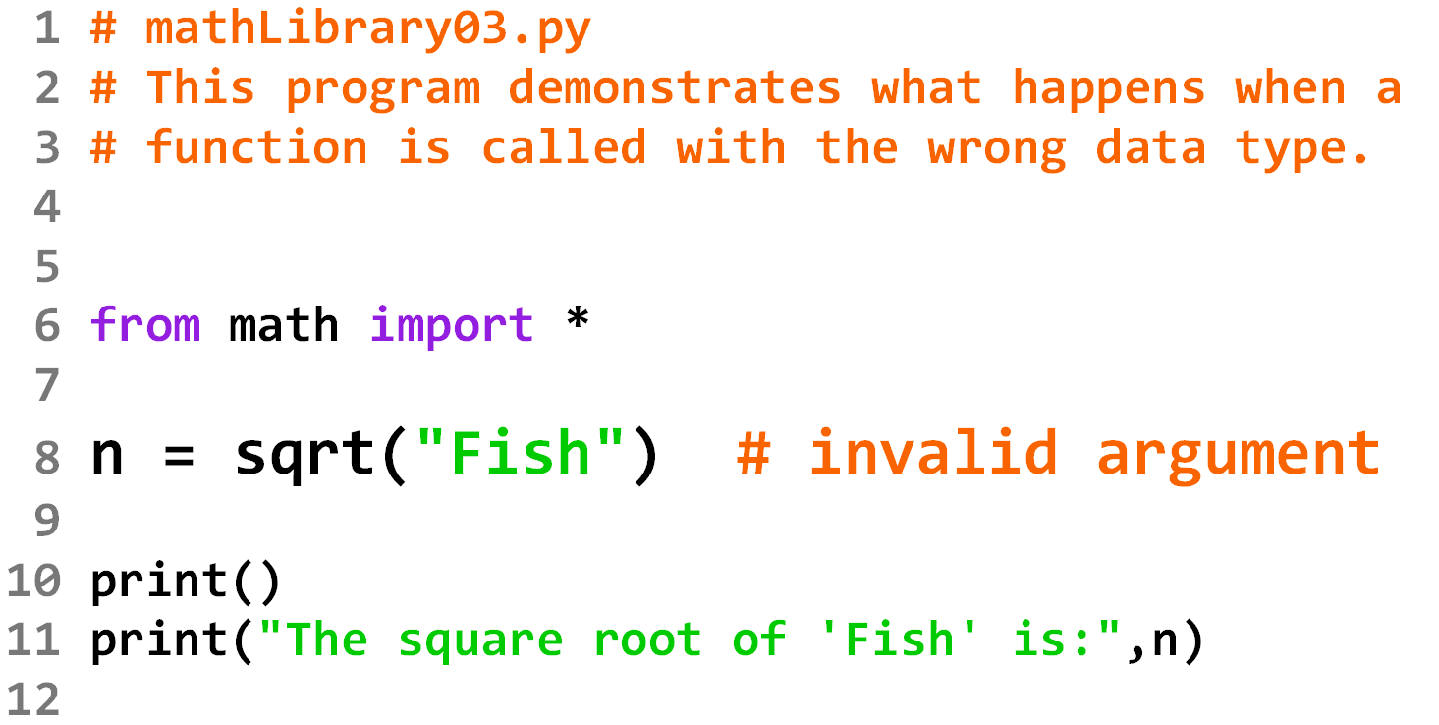

Slide 13
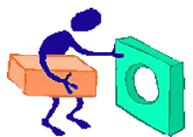
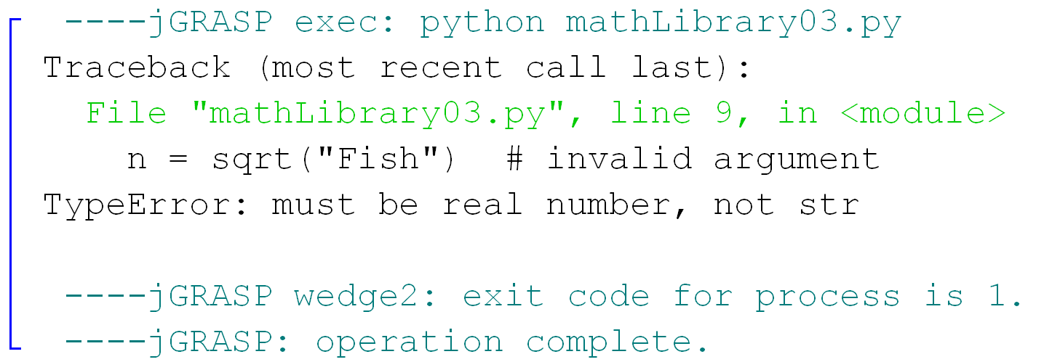

Slide 14
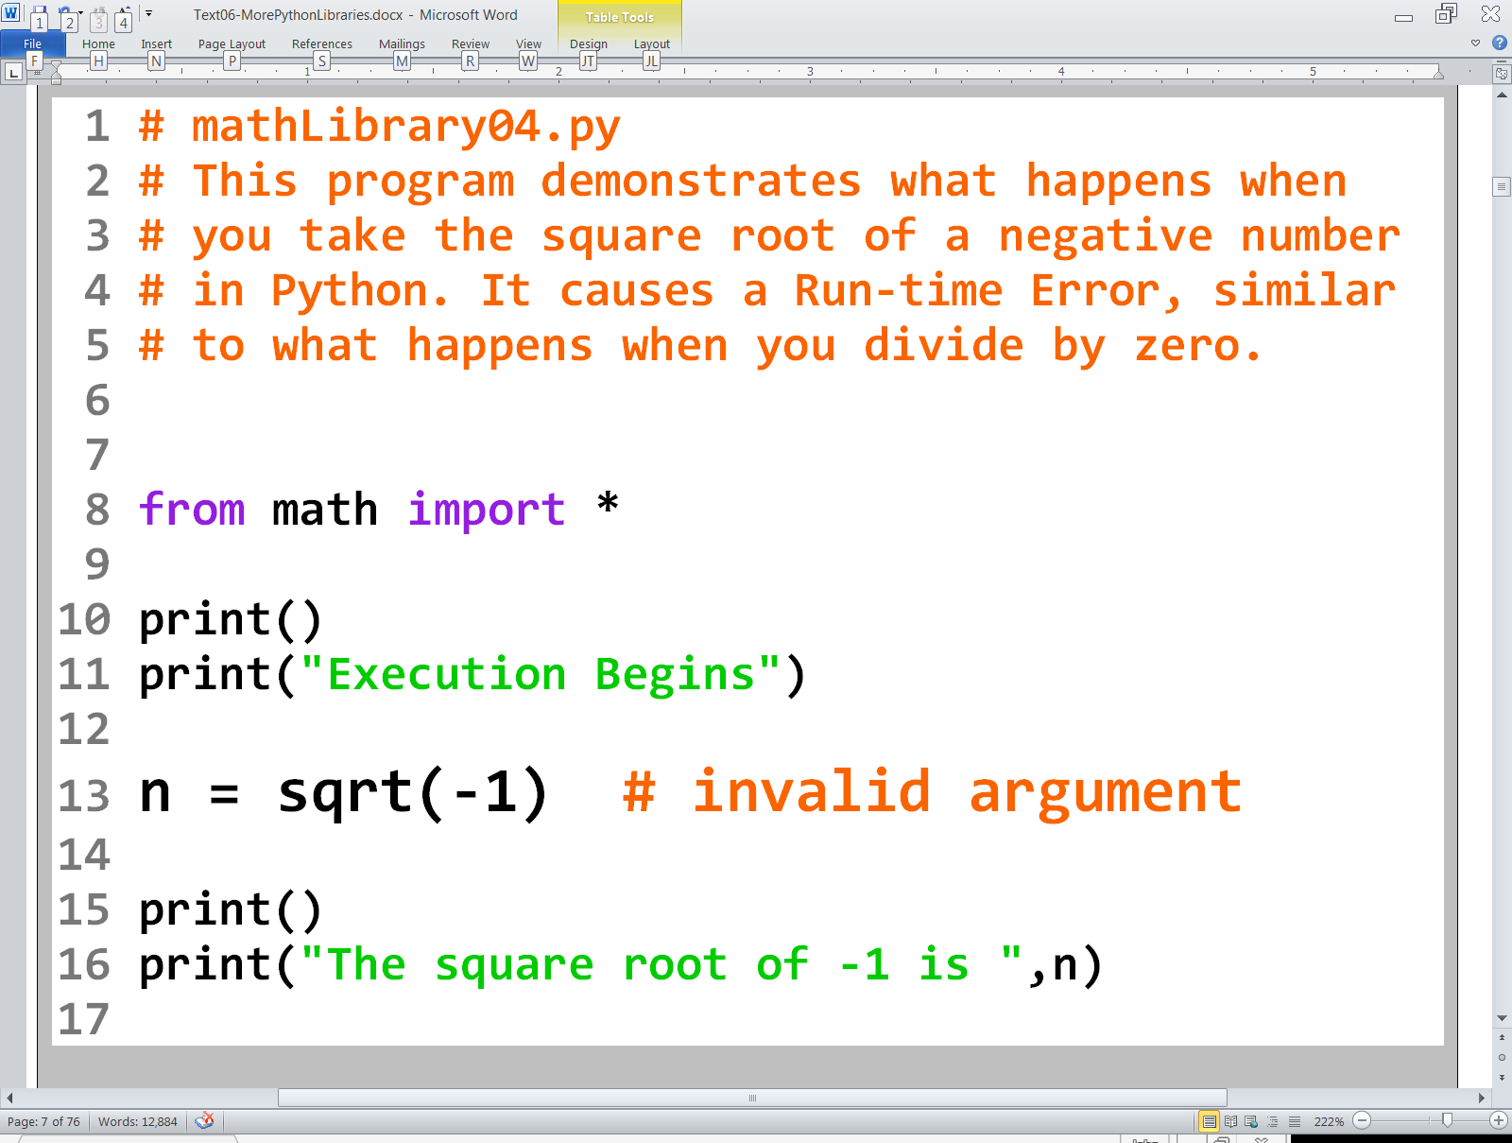

Slide 15
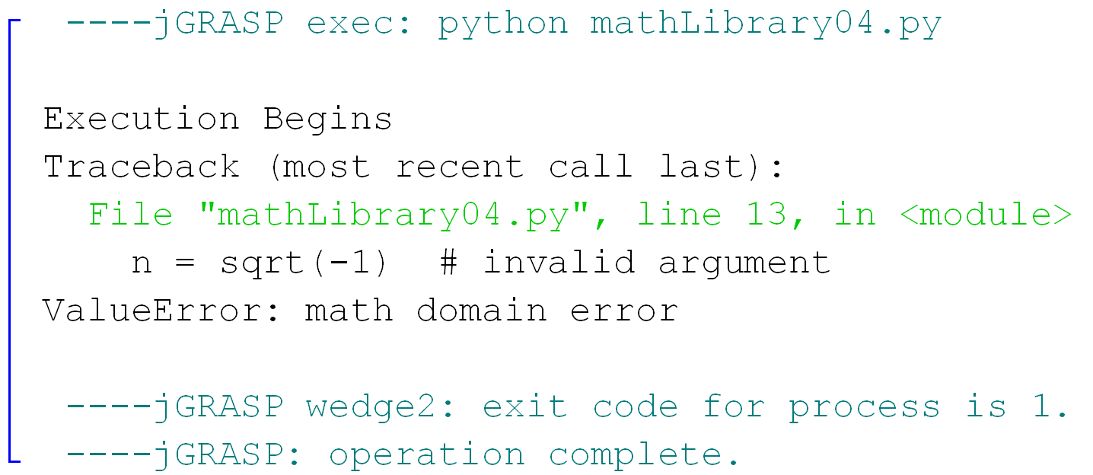

Slide 16
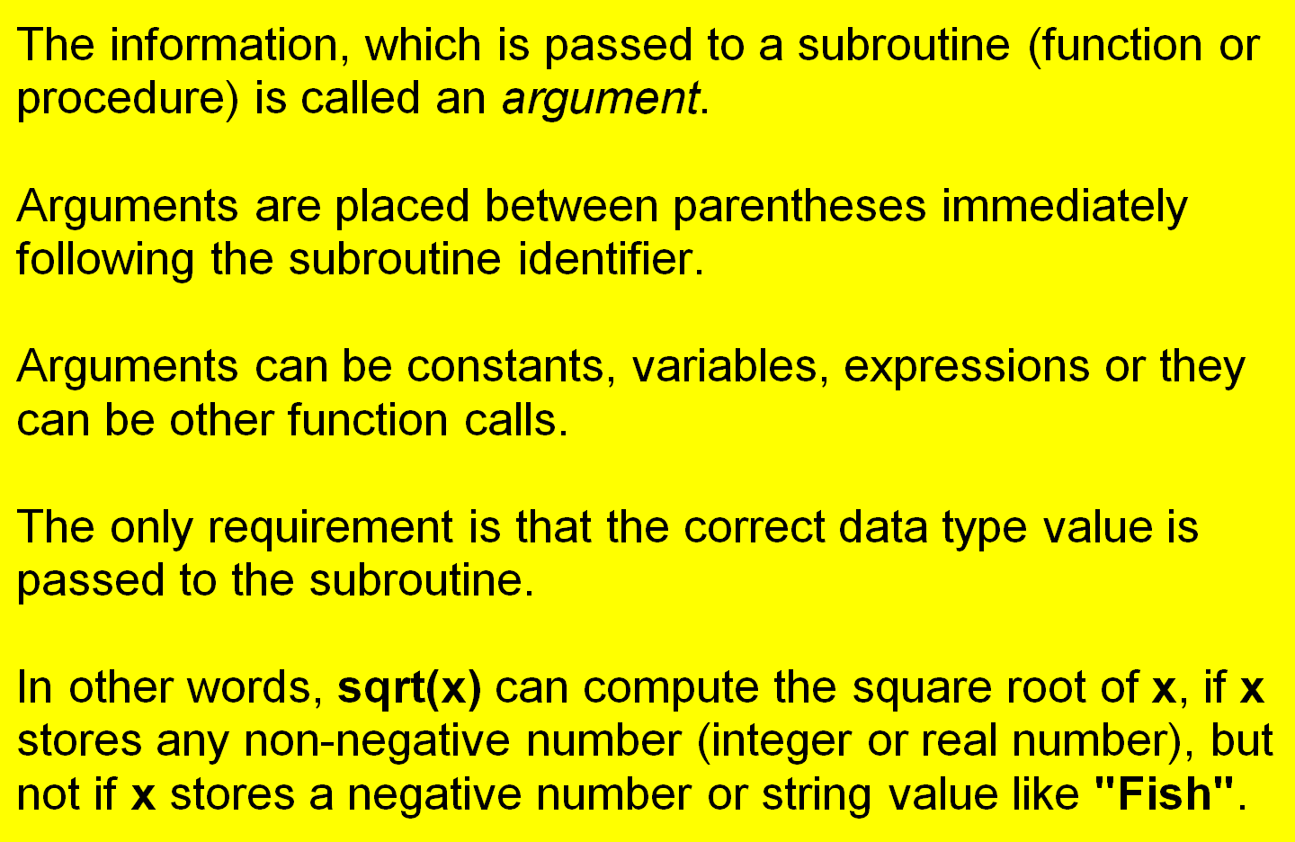
Subroutine Arguments

Slide 17
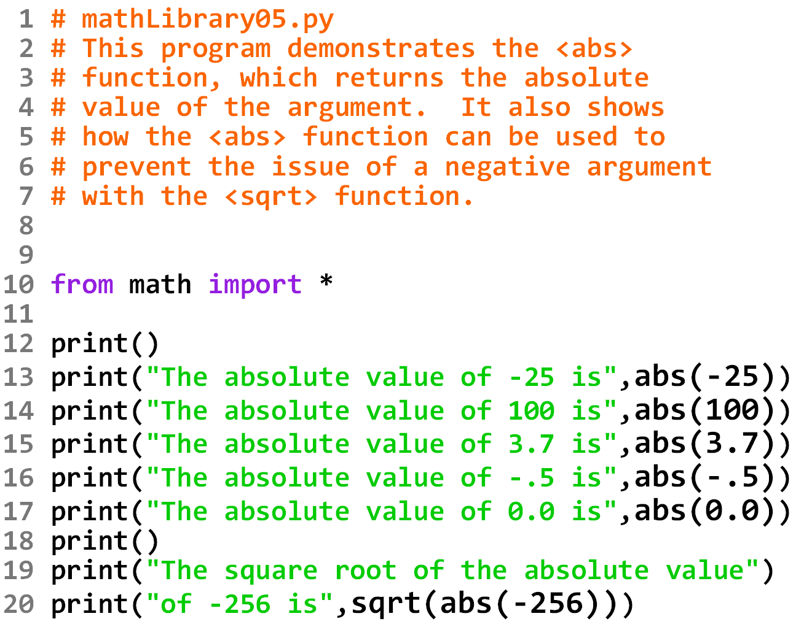

Slide 18
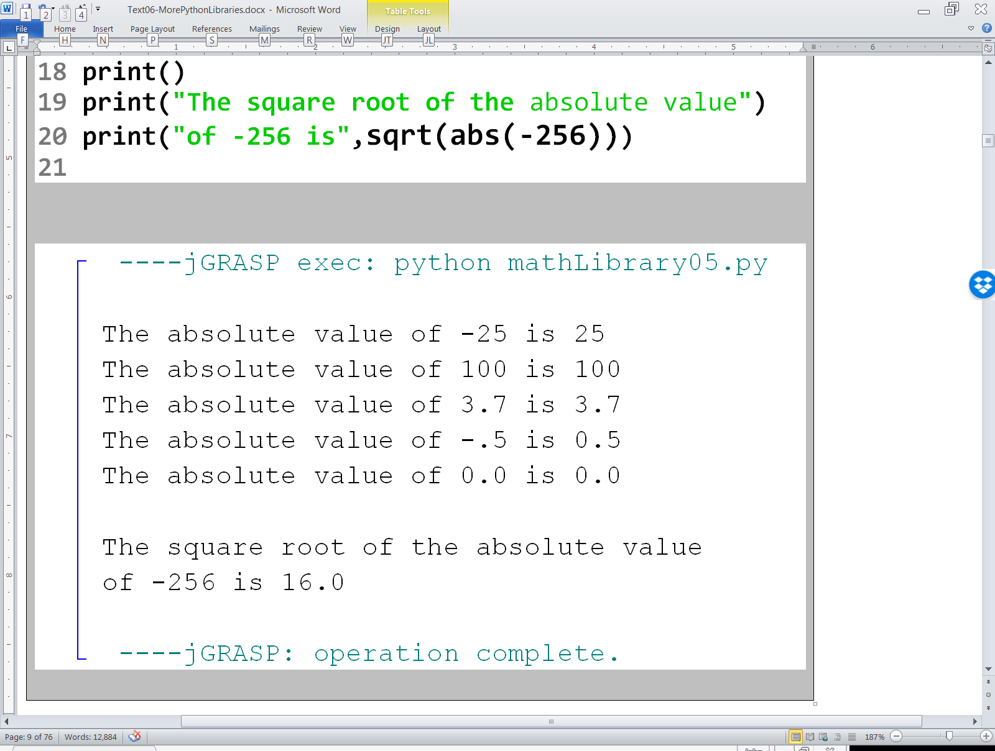

Slide 19
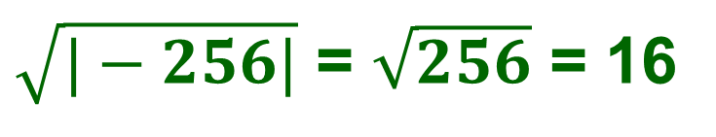
$\sqrt{|−256|}$ = $\sqrt{256}$ = 16

Slide 20
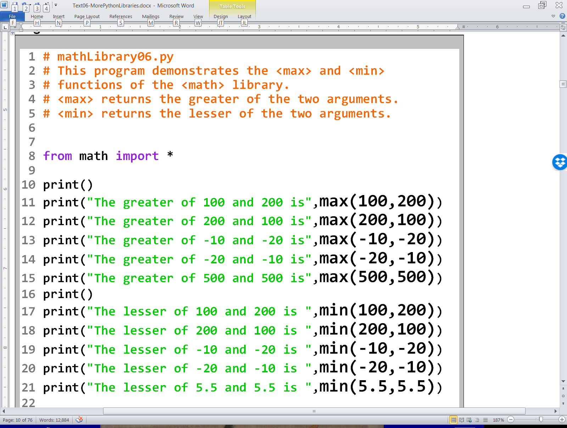

Slide 21
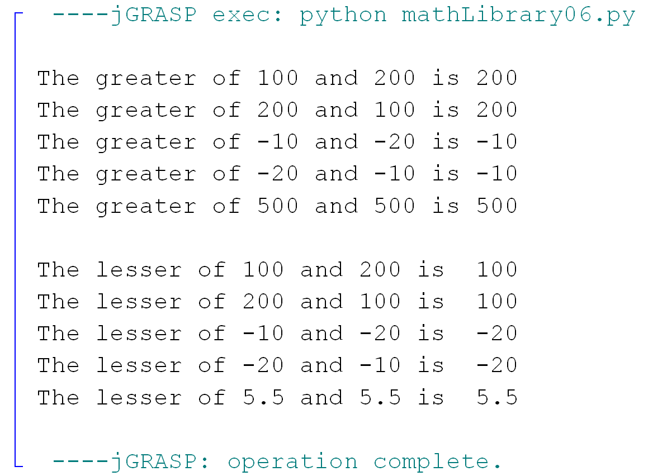

Slide 22
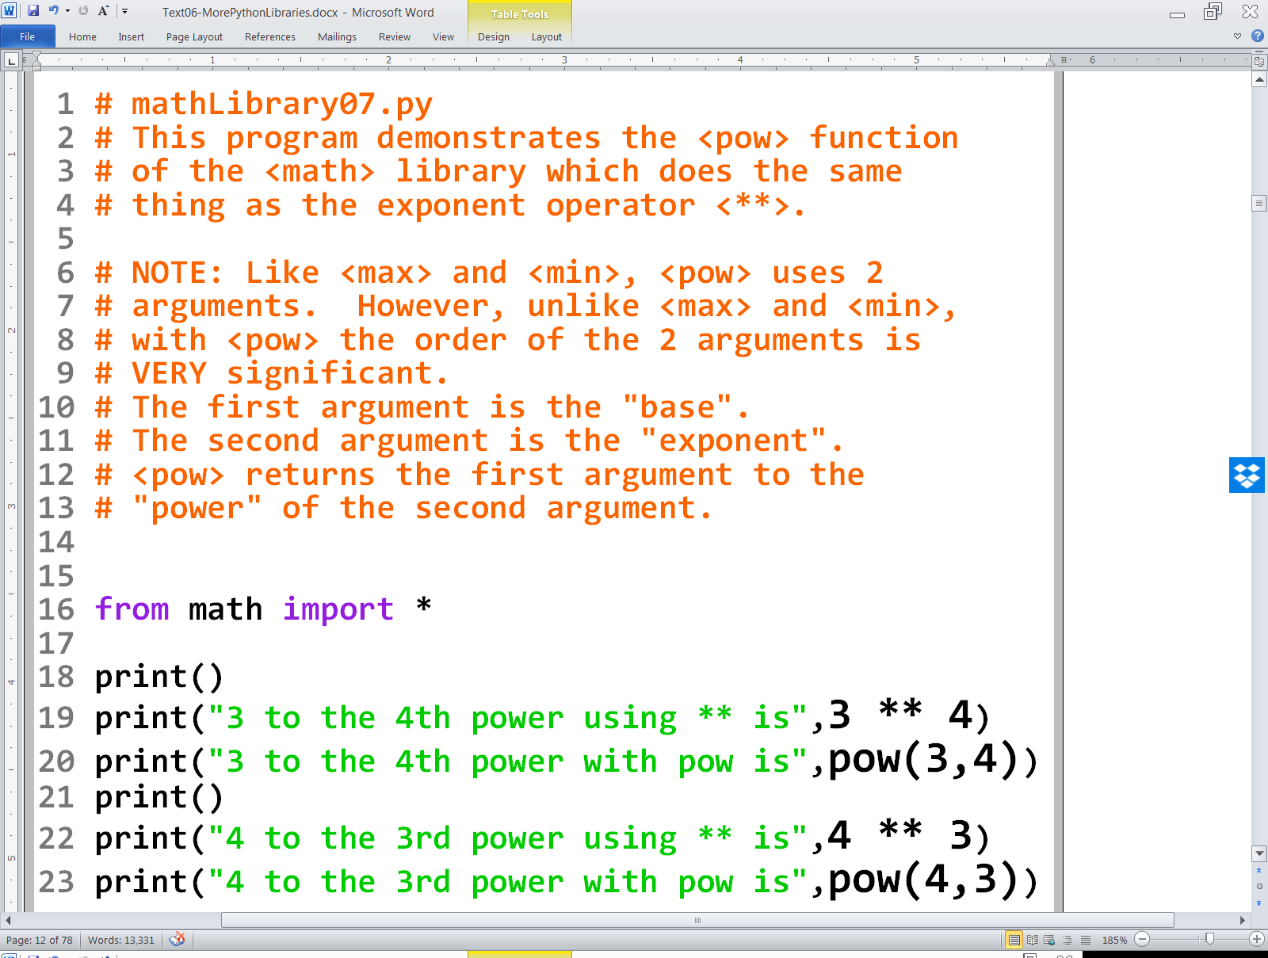

Slide 23
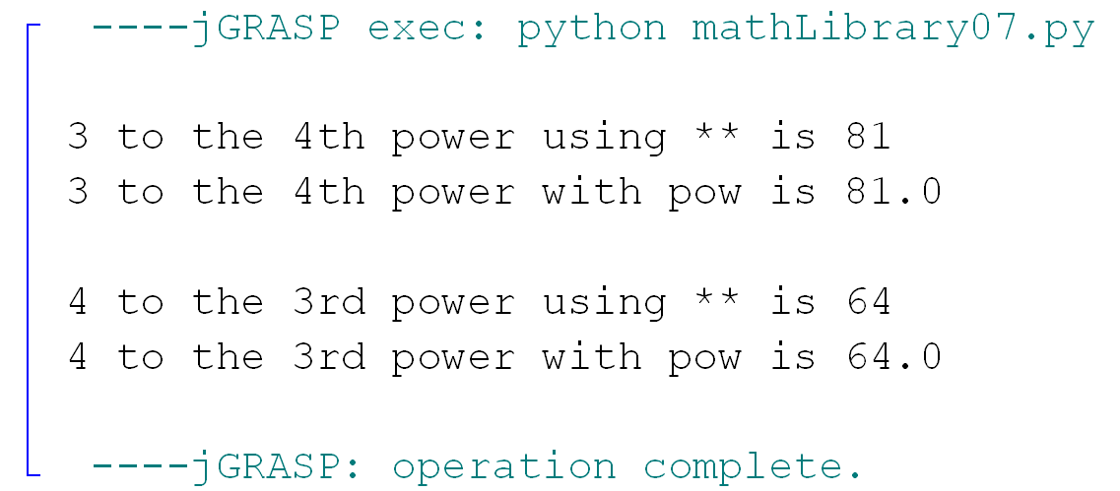

Slide 24
3⁴ = 81 4³ = 64

Slide 25
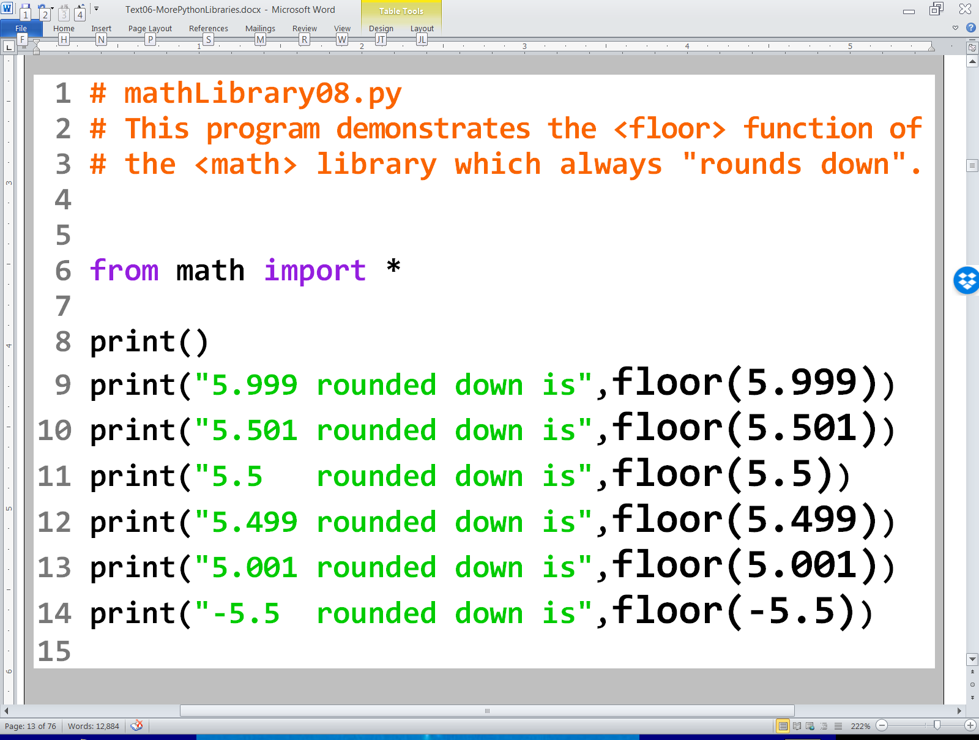

Slide 26
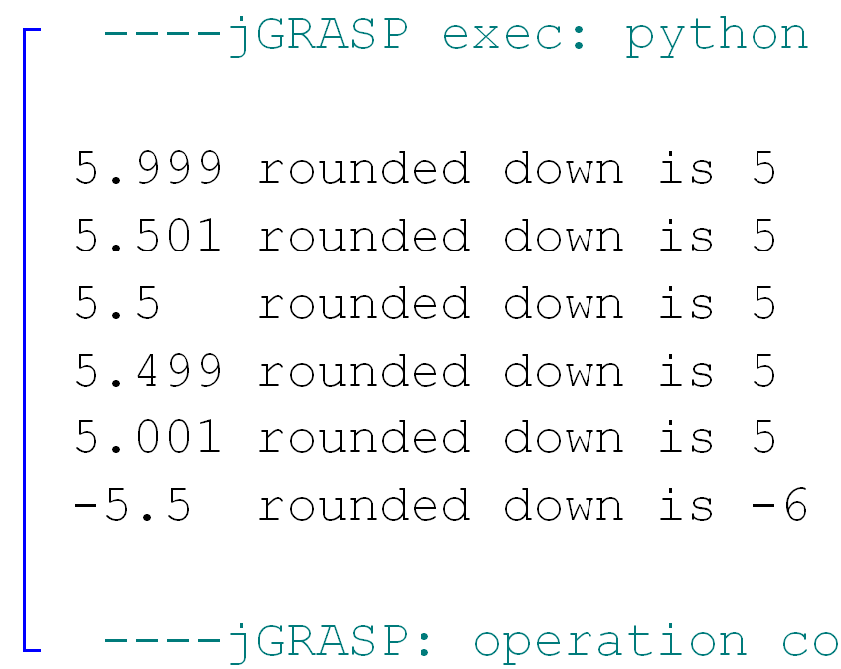

Slide 27
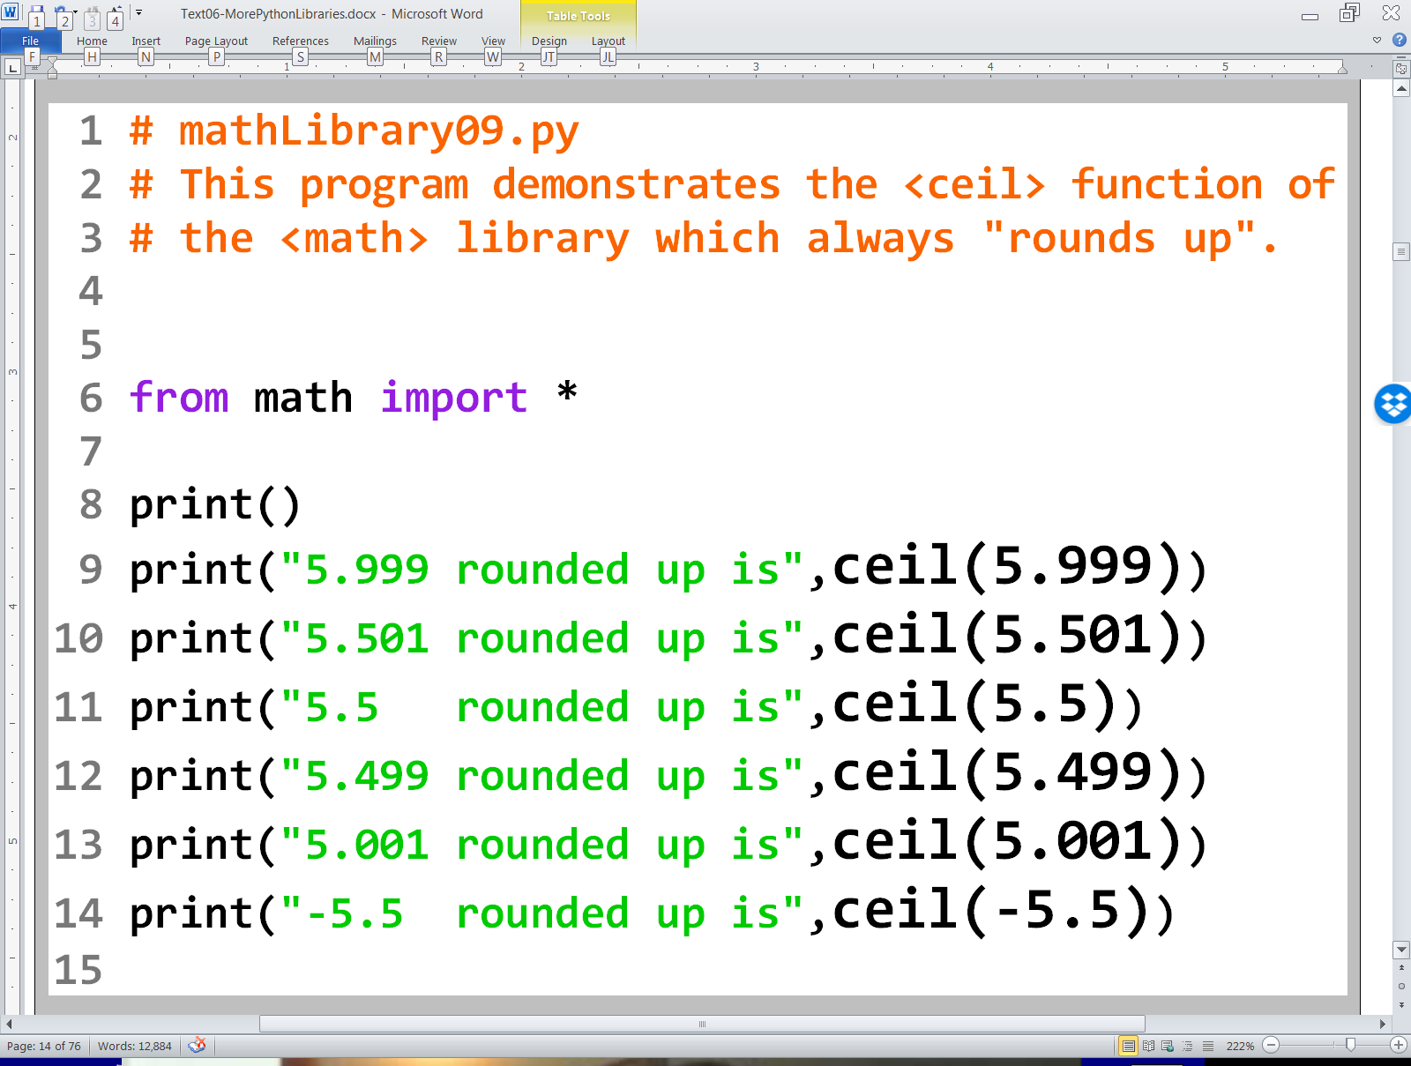

Slide 28
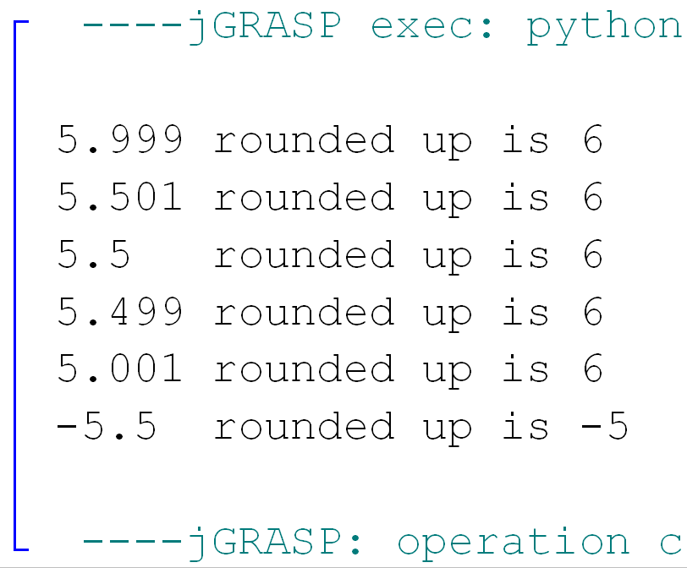

Slide 29
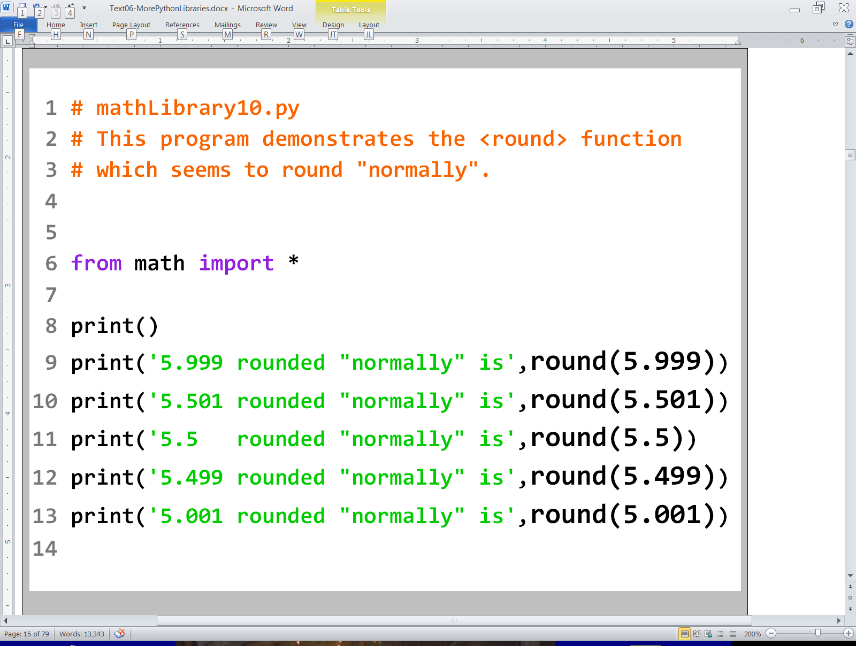

Slide 30
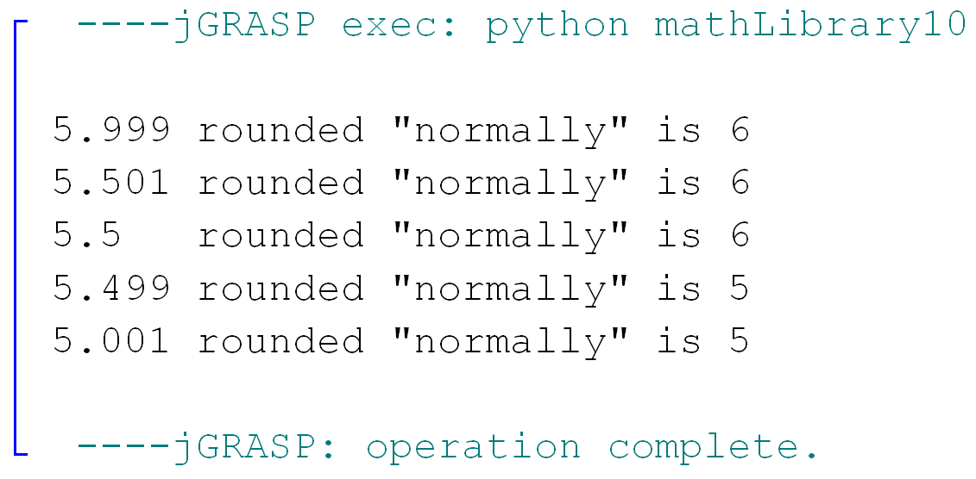

Slide 31
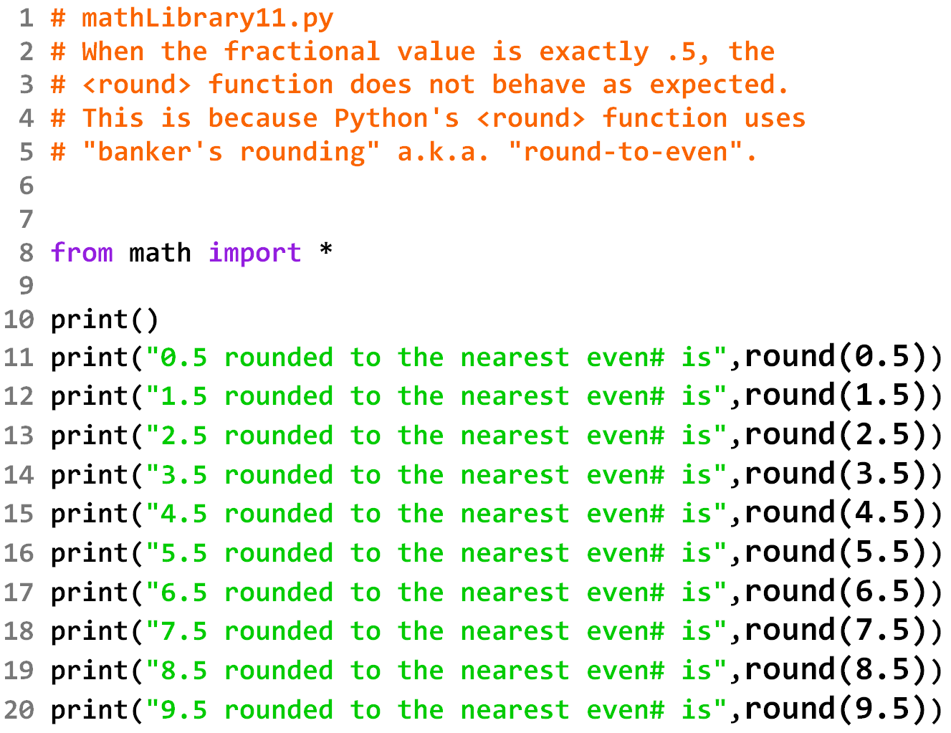

Slide 32
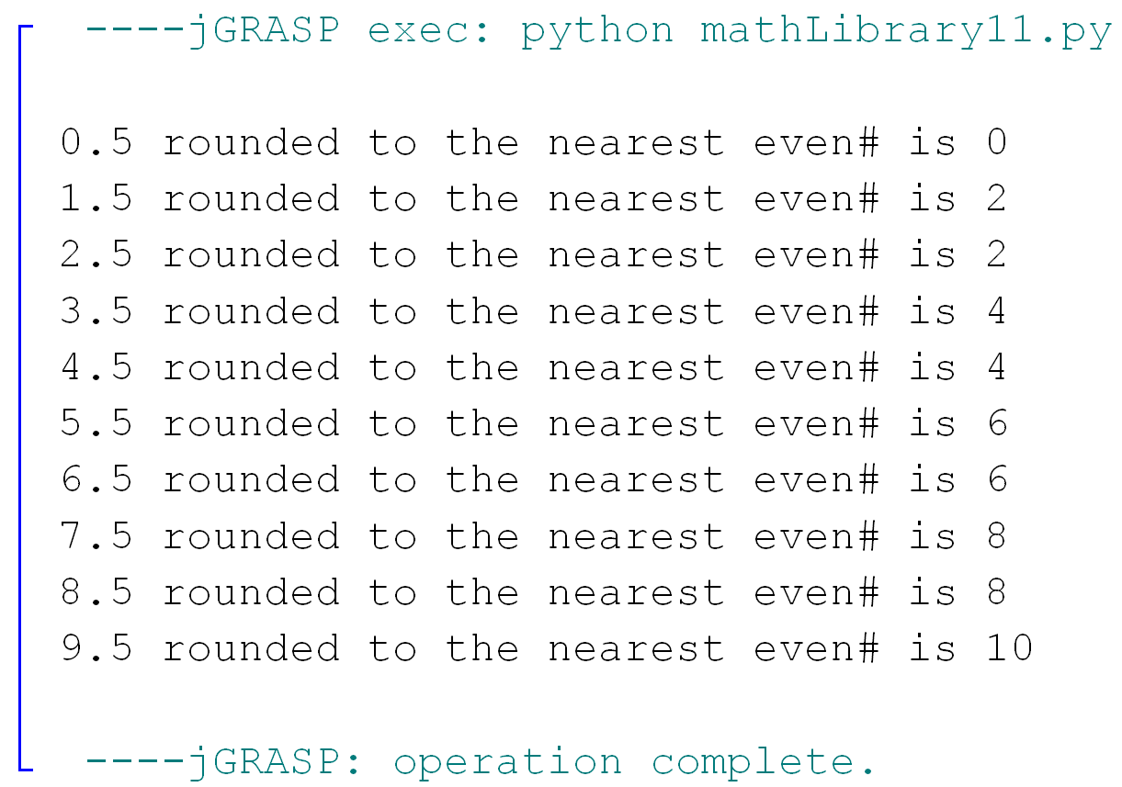

Slide 33
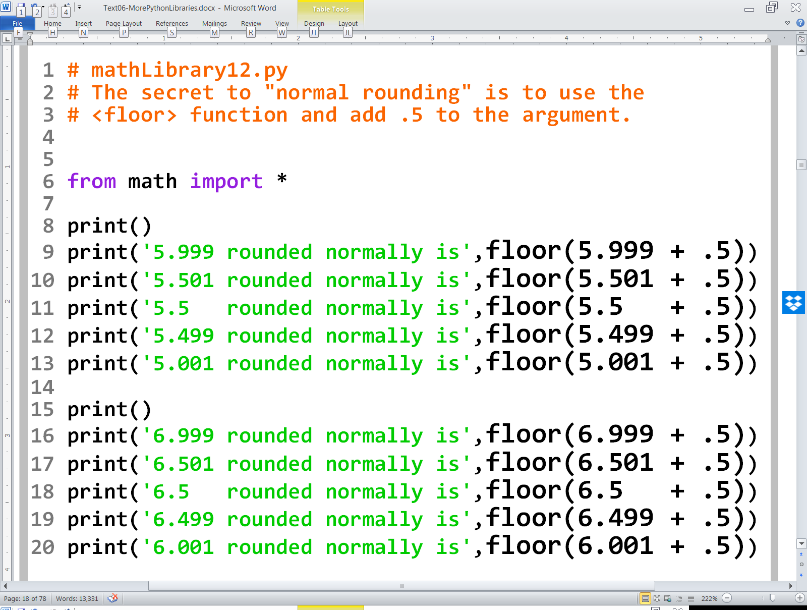

Slide 34
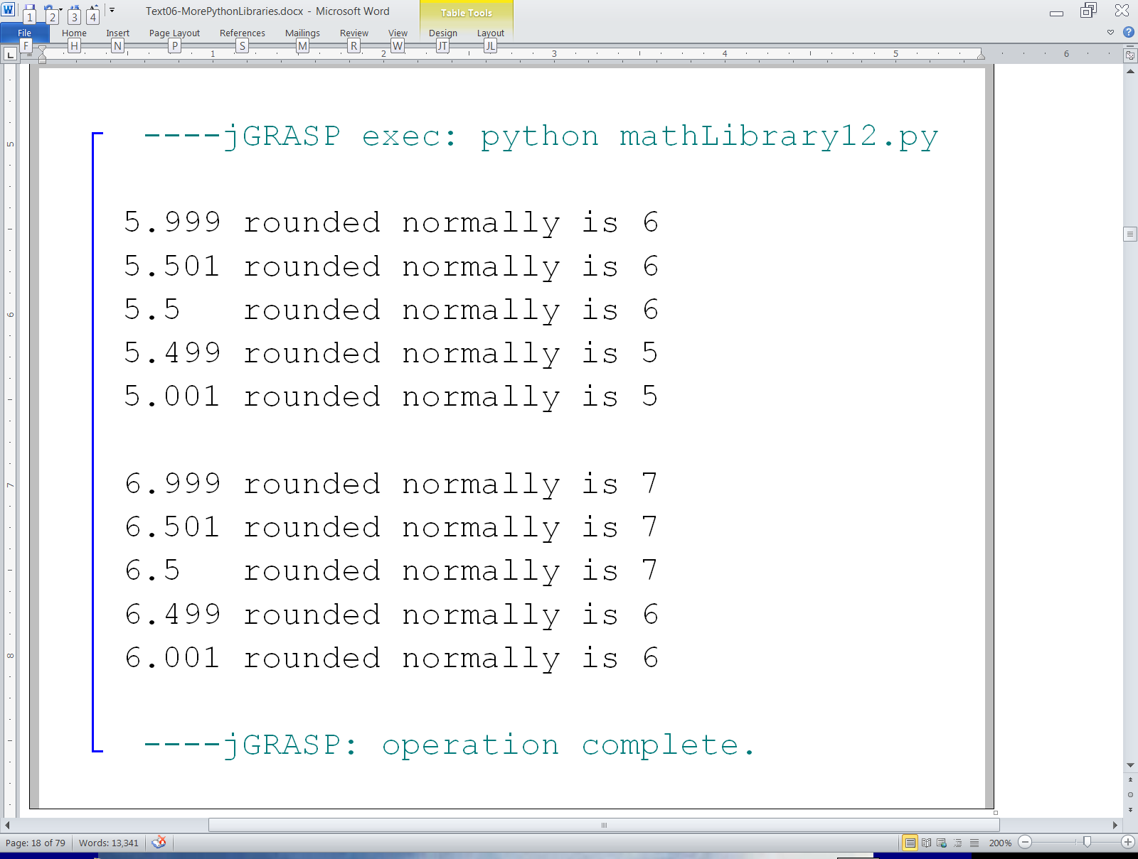

Slide 35
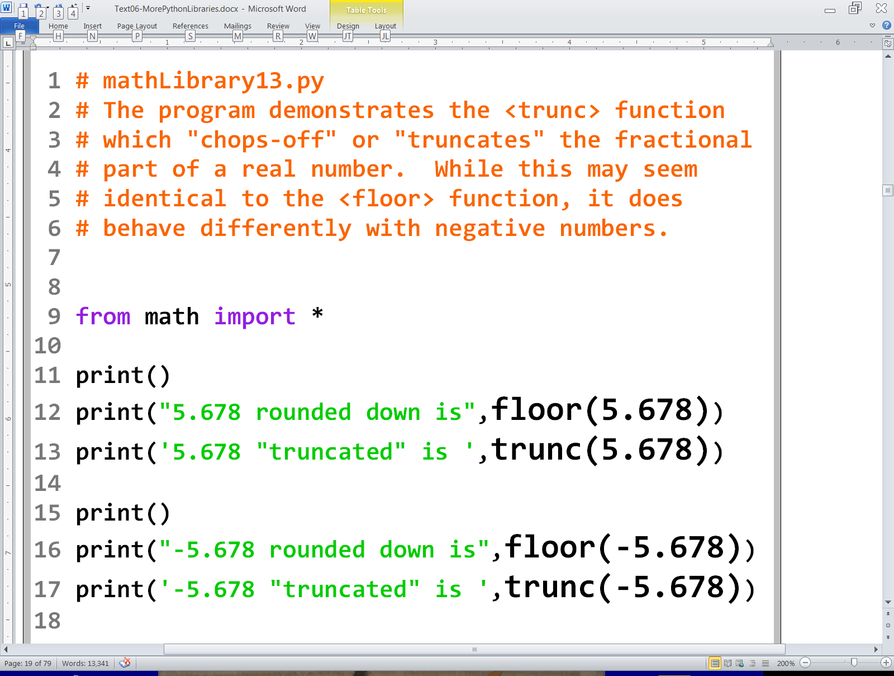

Slide 36
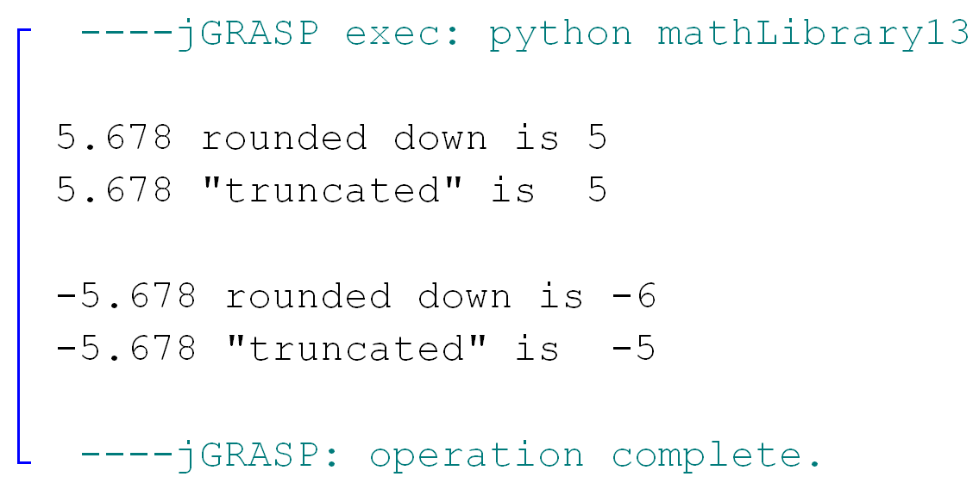

Slide 37
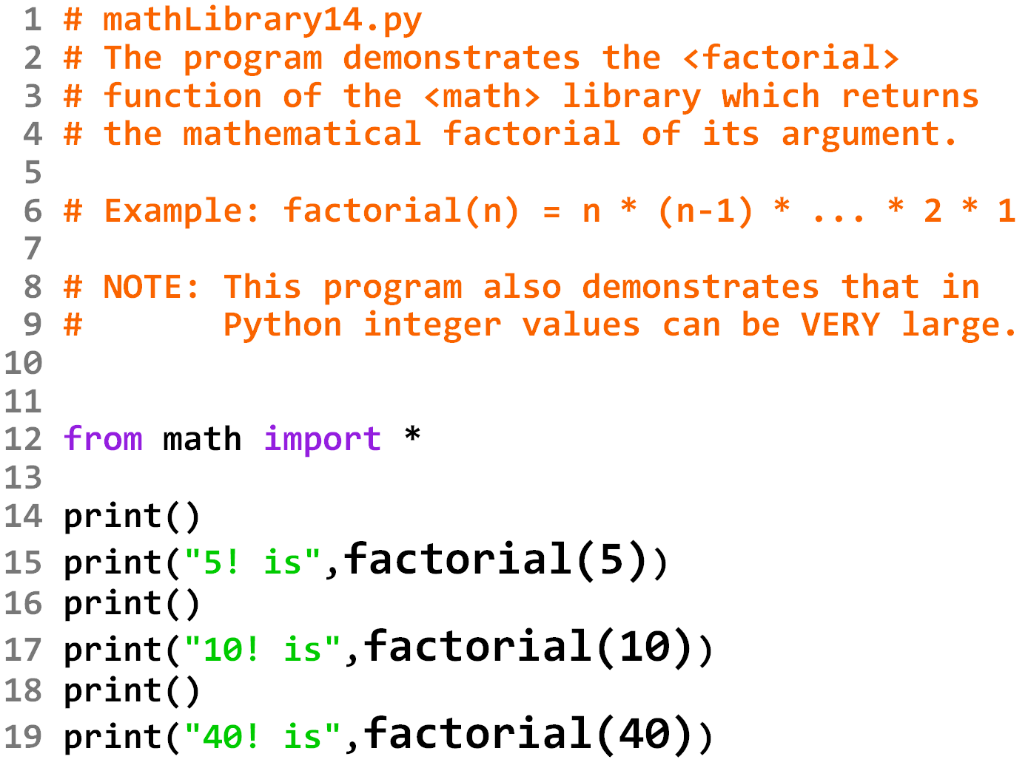

Slide 38
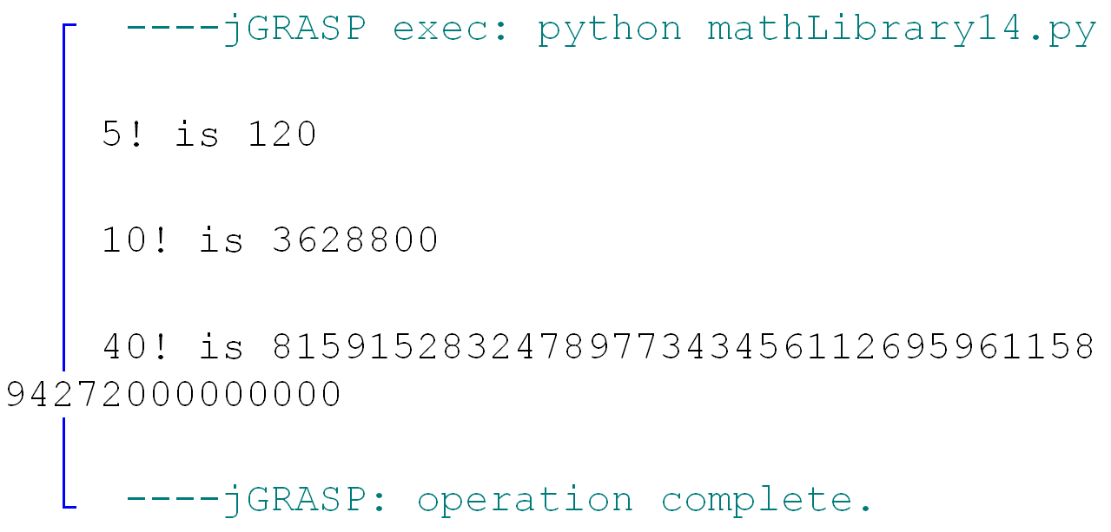

Slide 39
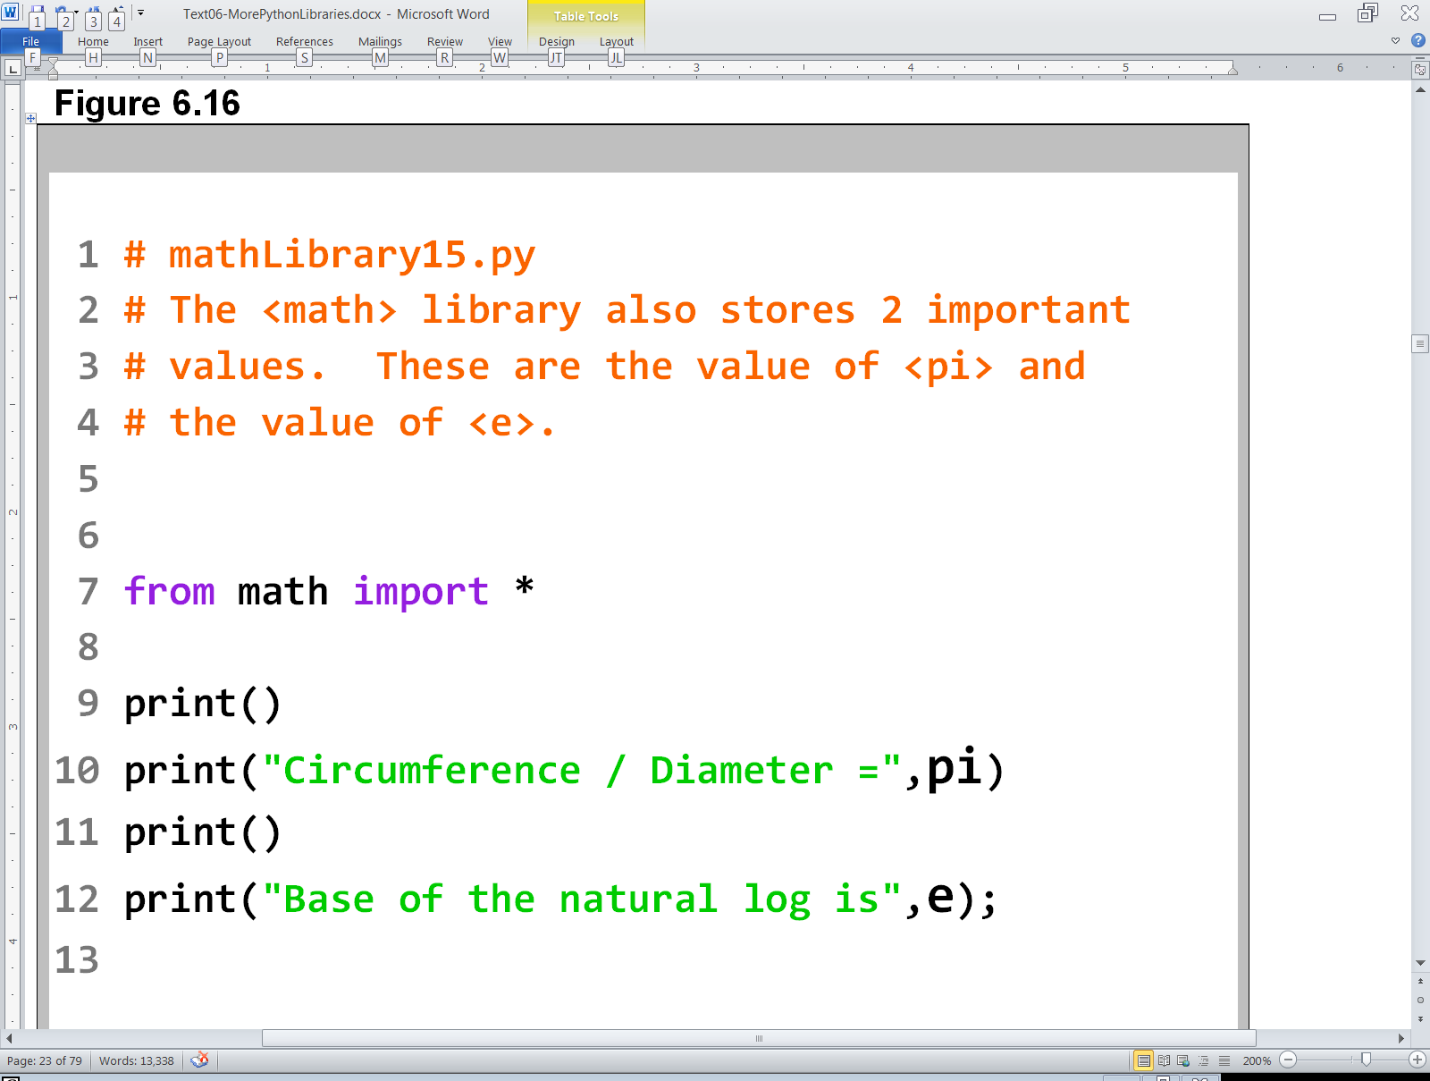

Slide 40
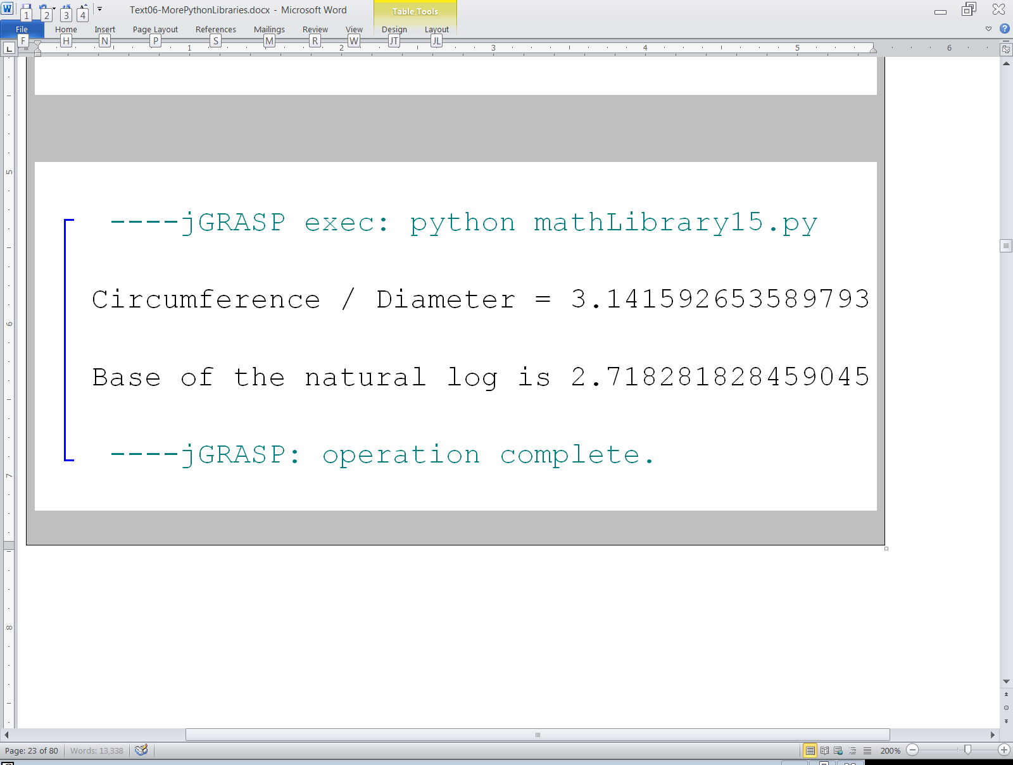
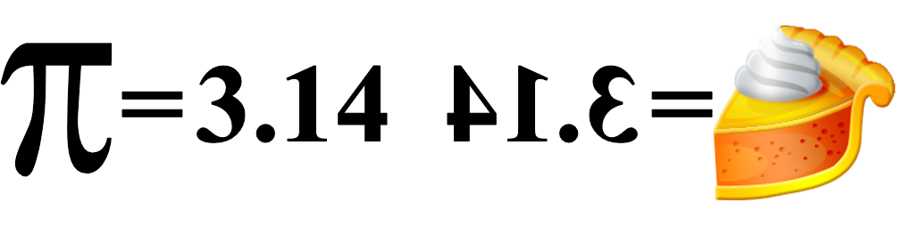

Slide 41
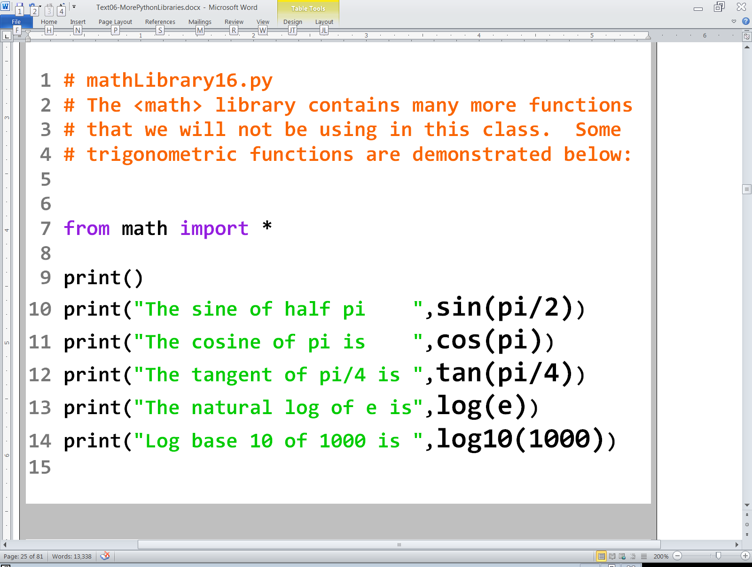

Slide 42
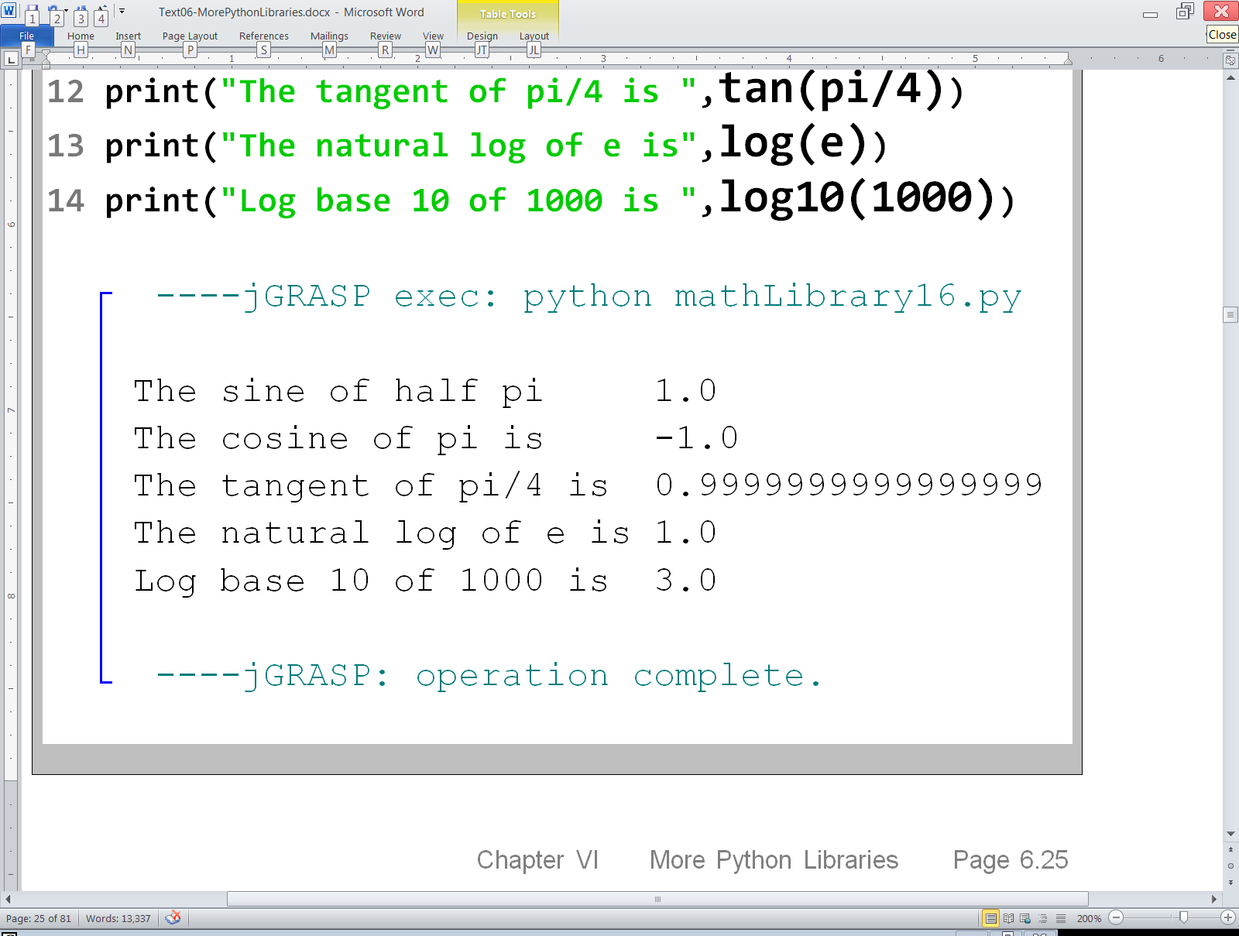

Slide 43

Python math Library Disclaimer
Not every function that is mathematical in nature is actually part of the math library. There are a couple functions, like round and abs, that can be used without importing math or any other library.
For the sake of simplicity, in this first year class, we will make no attempt to differentiate the mathematical functions that require importing the math library from the ones that do not. Instead, we will simply import the math library any time we use any function that is mathematical in nature… which does not hurt anything.

